Slide 1
Capstone Project-1
EDA On Hotel Booking Analysis
BY
Deepak Bharti
(Cohort jerusalem)

Slide 2
❖ Problem Statement:
For this project we will be analyzing Hotel Booking data. This data set contains booking information for a city hotel and a resort hotel, and includes information such as when the booking was made, length of stay, the number of adults, children, and/or babies, and the number of available parking spaces.
Hotel industry is a very volatile industry and the bookings depends on above factors and many more.
The main objective behind this project is to explore and analyze data to discover important factors that govern the bookings and give insights to hotel management ,which can perform various campaigns to boost the business and performance.

Slide 3
Work Flow :
Data Collection and Understanding
Data Cleaning and Manipulation
Exploratory Data Analysis(EDA)
EDA will be divided into following 3 analysis.
Univariate analysis: Univariate analysis is the simplest of the three analyses where the data you are analyzing is only one variable.
Bivariate analysis: Bivariate analysis is where you are comparing two variables to study their relationships.
Multivariate anlysis: Multivariate analysis is similar to Bivariate analysis but you are comparing more than two variables.

Slide 4
Data Collection and Understanding:
After collecting data it’s very important to understand your data. So we had hotel Booking analysis data. Which had 119390 rows and 32 columns. So let’s understand this 32 columns.
Data Description:
hotel :Resort Hotel or City Hotel
is_canceled : Value indicating if the booking was canceled (1) or not (0)
hotel :Resort Hotel or City Hotel is_canceled : Value indicating if the booking was canceled (1) or not (0).
lead_time : Number of days that elapsed between the entering date of the booking and the arrival date
arrival_date_year : Year of arrival date
arrival_date_month : Month of arrival date
arrival_date_week_number : Week number of year for arrival date
arrival_date_day_of_month : Day of arrival date
stays_in_weekend_nights : Number of weekend nights
stays_in_week_nights : Number of week nights.
adults : Number of adults
children : Number of children
babies : Number of babies meal : Type of meal booked.
country : Country of origin

Slide 5
❖ Data Collection and Understanding:
market_segment : Market segment designation. (TA/TO)
distribution_channel : Booking distribution channel.(T/A/TO)
is_repeated_guest : is a repeated guest (1) or not (0)
previous_cancellations : Number of previous bookings that were cancelled by the customer prior to the current booking
previous_bookings_not_canceled : Number of previous bookings not cancelled by the customer prior to the current booking
reserved_room_type : Code of room type reserved.
assigned_room_type : Code for the type of room assigned to the booking. booking_changes : Number of changes made to the booking from the moment the booking was entered on the PMS until the moment of check-in or cancellation deposit_type : No Deposit, Non Refund , Refundable.
agent : ID of the travel agency that made the booking
company : ID of the company/entity that made the booking .

Slide 6
days_in_waiting_list : Number of days the booking was in the waiting list before it was confirmed to the customer
customer_type : type of customer. Contract,Group,transient,Transient party.
adr : Average Daily Rate as defined by dividing the sum of all lodging transactions by the total number of staying nights
required_car_parking_spaces : Number of car parking spaces required by the customer
total_of_special_requests : Number of special requests made by the customer (e.g. twin bed or high floor)
reservation_status : Reservation last status

Slide 7
❖ Data Cleaning and Manipulation:
➢ There were 4 columns company, agent, country and children with missing values.
df1.isnull().sum().sort_values(ascending = False)[:6] # Columns having missing values. company 82137
agent 12193
country 452
children 4
reserved_room_type 0
assigned_room_type 0
dtype: int64
# Checking if all null values are removed
df1.isnull().sum().sort_values(ascending = False)[:6]
hotel 0
is_canceled 0
reservation_status 0 total_of_special_requests 0 required_car_parking_spaces 0
adr 0
dtype: int64

Slide 8
df1.drop(df1[df1['adults']+df1['babies']+df1['children'] == 0].index, inplace = True)
df1[['children', 'company', 'agent']] = df1[['children', 'company', 'agent']].astype('int64')
df1['country'].fillna('others', inplace = True)
Handling Duplicates: Data had 31994 duplicates values. So we dropped it from the data.
#Step 1: Removing duplicate rows if any
df1[df1.duplicated()].shape # Show no. of rows of duplicate rows duplicate rows
# Dropping duplicate values
df1.drop_duplicates(inplace = True)

Slide 9
Univariate Analysis
While doing univariate analysis of given hotel booking dataset, we answered following questions:
Which agent made most of bookings?
Which room type is in most demand and which room type generates highest adr?
From which country most of the customers are coming?
What is the most preferred meal by customers?

Slide 10
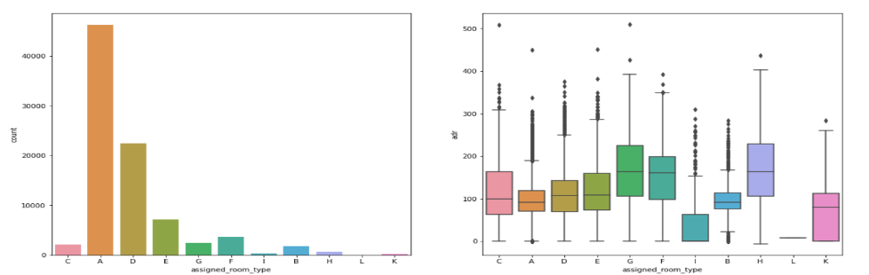
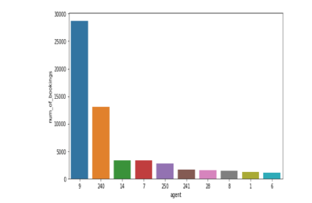

Slide 11
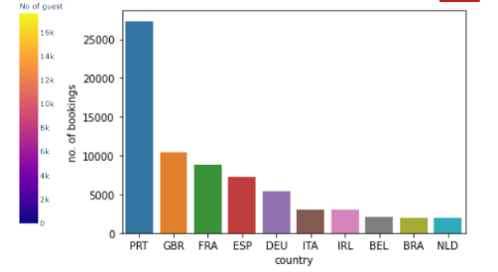
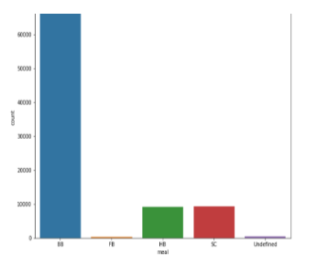
• Type A room is most demanded by customers.
Room types C, G and H are some of the highest adr(average daily rate) generating rooms.
Agent with id no. 9 made most of the bookings.
• Most of the customers from European countries like Portugal, Great Britain, France and Spain.
Most preferred meal type is BB( Bed and breakfast).

Slide 12
Hotel wise Analysis
While doing hotel-wise analysis of given hotel booking dataset, we answered following questions:
Percentage of bookings in each hotels?
Which hotel makes more revenue?
Which hotel has higher lead time?
What is most preferred stay length in each hotel?
For which hotel, does people have to wait longer to get a booking confirmed?
Which hotel has higher booking cancellations rate?
Which hotel have higher and how much customer returning rate?

Slide 13
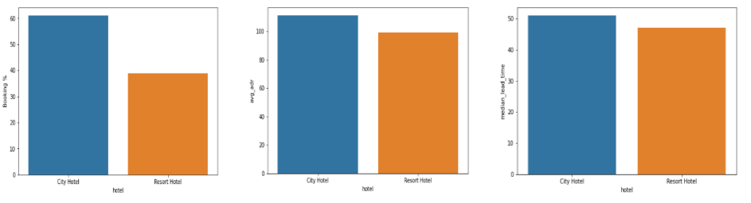
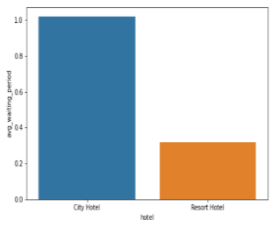
• Around 60% bookings are for City hotel and 40% bookings are for Resort hotel.
• Avg adr of Resort hotel is slightly lower than that of City hotel. Hence, City hotel seems to be making slightly more revenue.
• City hotel has slightly higher median lead time. Also median lead time is significantly higher in each case, this means customers generally plan their hotel visits way to early.
• City hotel has significantly longer waiting time, hence City Hotel is much busier than Resort Hotel.

Slide 14
Distribution channel wise Analysis
While doing Distribution channel wise analysis of given hotel booking dataset, we answered following questions:
Which is the most common channel for booking hotels?
Which channel is mostly used for early booking of hotels?
Which distribution channel brings better revenue generating deals for hotels?

Slide 15
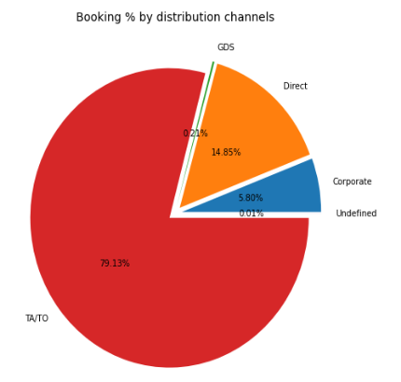
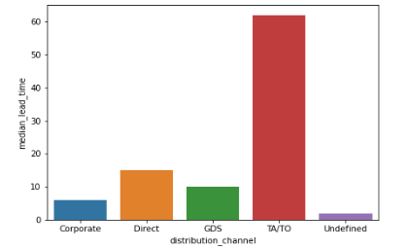
Distribution channel wise Analysis

Slide 16
Here we can see that the most of guest are making reservation through TA/TO channels which is travel agency and tour operator.
Than the second most used channel is direct.
Channel which is mostly used for early booking of hotels is also TA/TO
GDS channel brings higher revenue generating deals for City hotel, in contrast to that most bookings come via TA/TO. City Hotel can work to increase outreach on GDS channels to get more higher revenue generating deals.
Resort hotel has more revenue generating deals by direct and TA/TO channel. Resort Hotel need to increase outreach on GDS channel to increase revenue

Slide 17
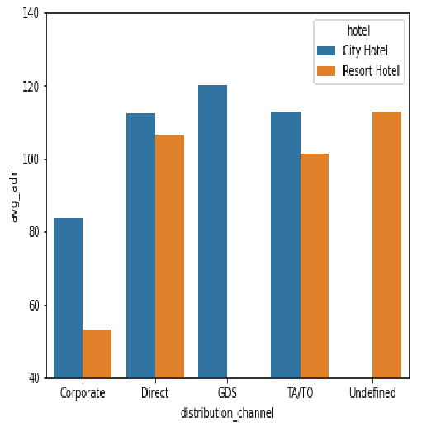

Slide 18
Booking cancellation Analysis
We analyze the following possible reasons for booking cancellations:
Which significant distribution channel has highest cancellation percentage?
Longer lead time.
Longer time (in days) in waiting list.
Not getting same room as reserved.
Does not getting same room as reserved effects adr?

Slide 19
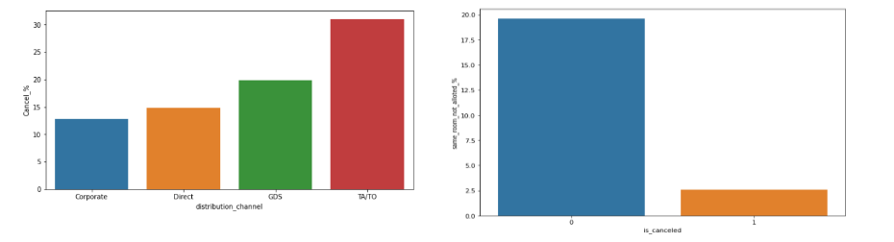
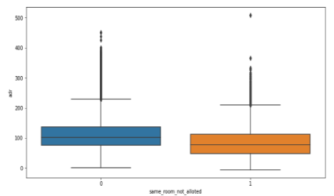
TA/TO has highest booking cancellation %. Therefore, a booking via TA/TO is 30% likely to get cancelled.
Not getting same room as demanded is not the case of cancellation of rooms. A significant percentage of bookings are not cancelled even after getting different room as demanded.
But, customers who didn't got same room have paid a little lower adr, except for few exceptions.

Slide 20
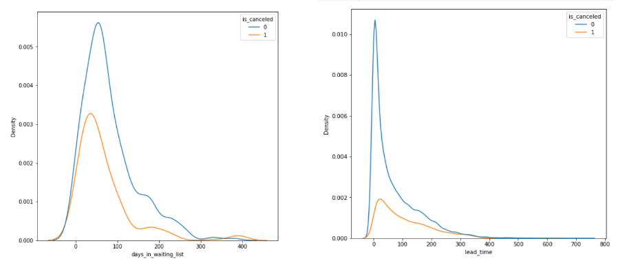
Most of the bookings that are cancelled have waiting period of less 150 days but also most of bookings that are not cancelled also have waiting period of less than 150 days. Hence this shows that waiting period has no effect on cancellation of bookings.
Also, lead time has no effect on cancellation of bookings, as both curves of cancellation and not cancelation are similar for lead time too.

Slide 21
Time-wise Analysis
While doing time-wise analysis of given hotel booking dataset, we answered following questions:
What are the most busy months for hotels?
In which months hotels charges higher adr?
How does booking numbers and adr changes within a month?
How does bookings varies along year for different types of customers.

Slide 22
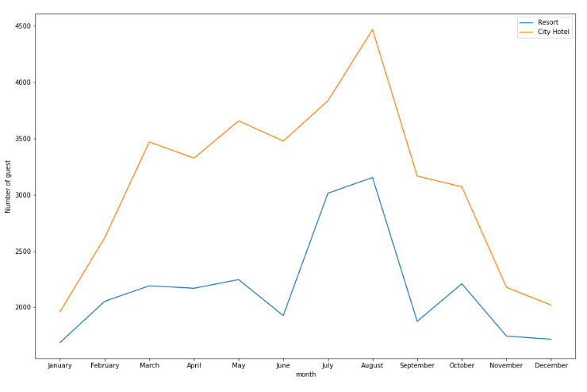
From the month of July to August the number of bookings increased and in August, City Hotel got most number of guests.

Slide 23
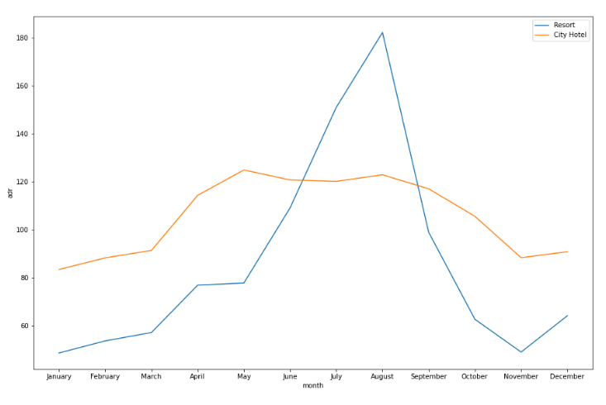
The revenue aspect looks different, the Resort Hotels receives more revenue with respect to City Hotel. From May to August there was rapid increase in adr. August recorded the highest.

Slide 24
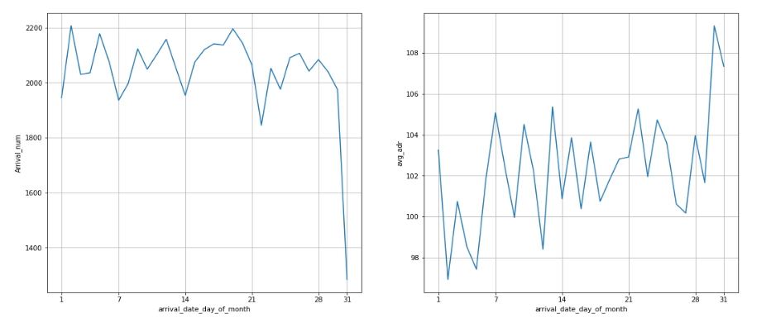
We can see that graph Arrival_num has small peaks at regular interval of days. This can be due to increase in arrival weekend.
Also, the avg adr tends to go up as month ends. Therefore charges are more at the end of month.

Slide 25
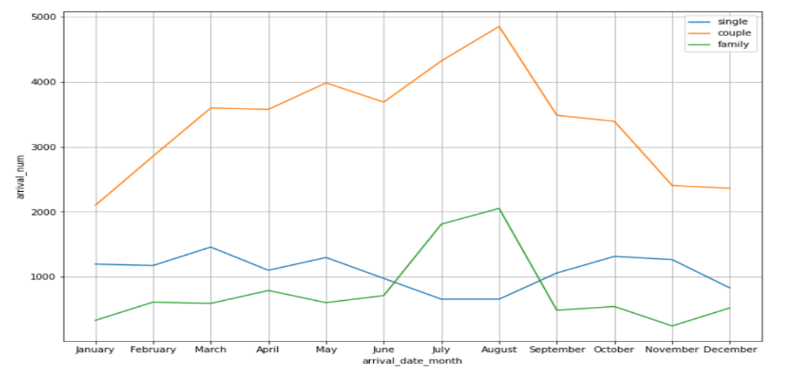
Mostly bookings are done by couples.
It is clear from graph that there is a sudden surge in arrival num of couples and family in months of July and August. So better plans can be planned accordingly at that time for these type of customers.

Slide 26
Some important questions
Some other analysis are also done, which are as follows: What are the different reason for special requests
What is the optimal stay length for better deal for customers
How Average daily rate is affected by total staying period in hotels

Slide 27
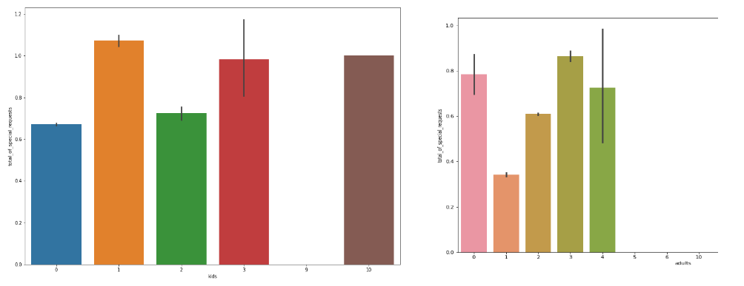
Reasons for special requests
The number of special request are almost the same in the kids section. But, we can see that if the adults are more than 2 there are more chances that hotels will receive more special requests.

Slide 28
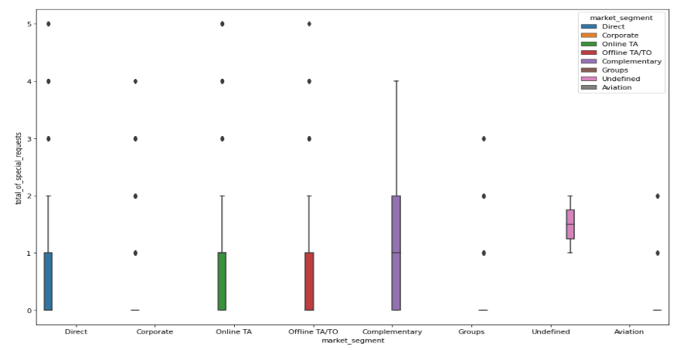
Reasons for special requests(cont.)
Here we can see that all market segment mostly have special request. There is one segment which is complementary, having more than average number of special request.

Slide 29
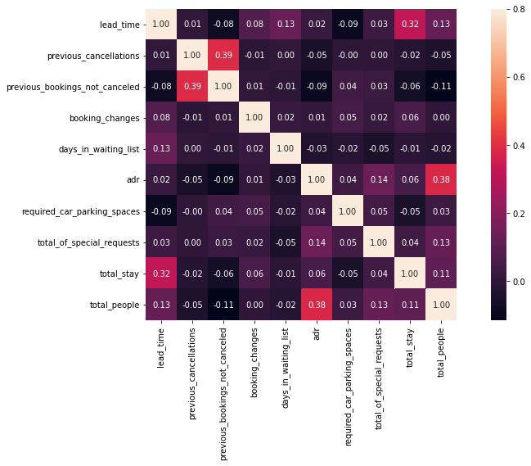
Correlation Heatmap
Total stay length and lead time are slightly correlated. This may means that for longer hotel stays, people generally plan little before the actual arrival.
adr is slightly correlated with total_people, which makes sense as more no. of people means more service to deliver, therefore more adr.

Slide 30
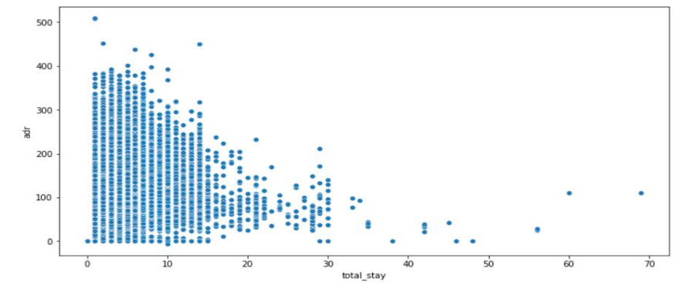
Optimal stay length for better deals in adr
For shorter stays the adr(average daily rate varies greatly) but for longer stays (> 15 days) adr is comparatively very less. Therefore, customers can get better deal for longer stays more than 15 days.

Slide 31
Conclusion
● Around 60% bookings are for City hotel and 40% bookings are for Resort hotel, therefore City Hotel is busier than Resort hotel. Also the overall adr of City hotel is slightly higher than Resort hotel. ● Mostly guests stay for less than 5 days in hotel and for longer stays Resort hotel is preferred. ● Both hotels have significantly higher booking cancellation rates and very few guests less than 3 % return for another booking in City hotel. 5% guests return for stay in Resort hotel. ● Most of the guests came from european countries, with most no. of guest coming from Portugal. ● Guests use different channels for making bookings out of which most preferred way is TA/TO. ● Almost 30% of bookings via TA/TO are cancelled. ● Not getting same room as reserved, longer lead time and waiting time do not affect cancellation of bookings. Although different room allotment do lowers the adr. ● July- August are the most busier and profitable months for both of hotels. ● Within a month, adr gradually increases as month ends, with small sudden rise on weekends. ● Couples are the most common guests for hotels, hence hotels can plan services according to couples needs to increase revenue. ● More number of people in guests results in more number of special requests. ● Bookings made via complementary market segment and adults have on average high no. of special request. ● For customers, generally the longer stays (more than 15 days) can result in better deals in terms of low adr.

Slide 32
Thank You

